Slide 1


Slide 2
INTERNET

Slide 3

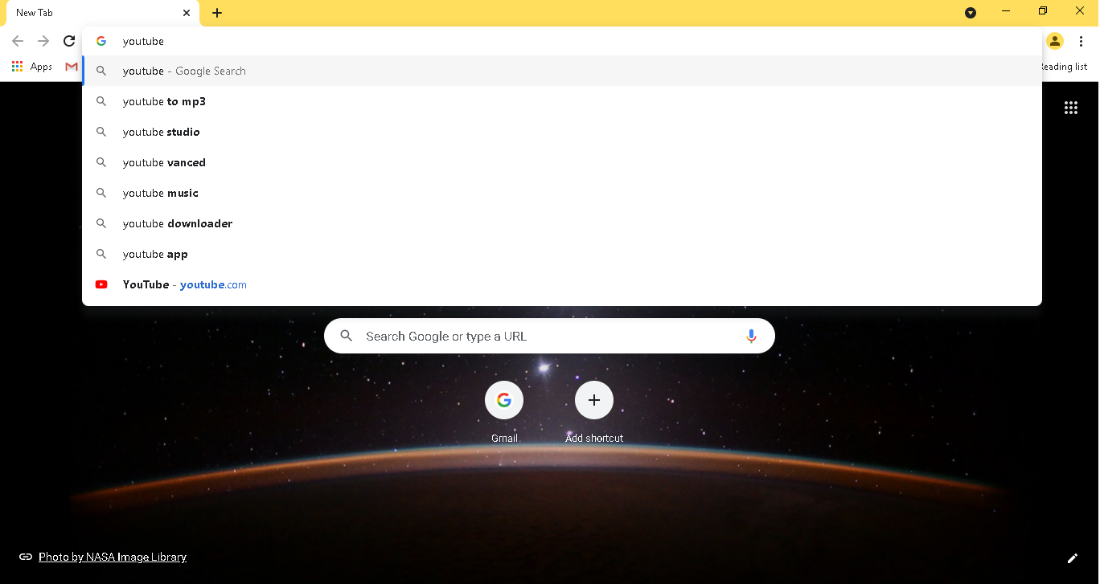
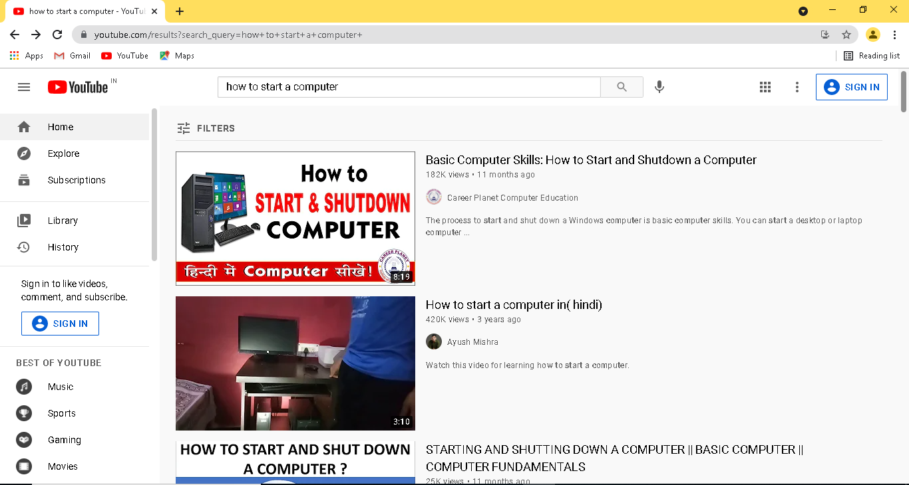
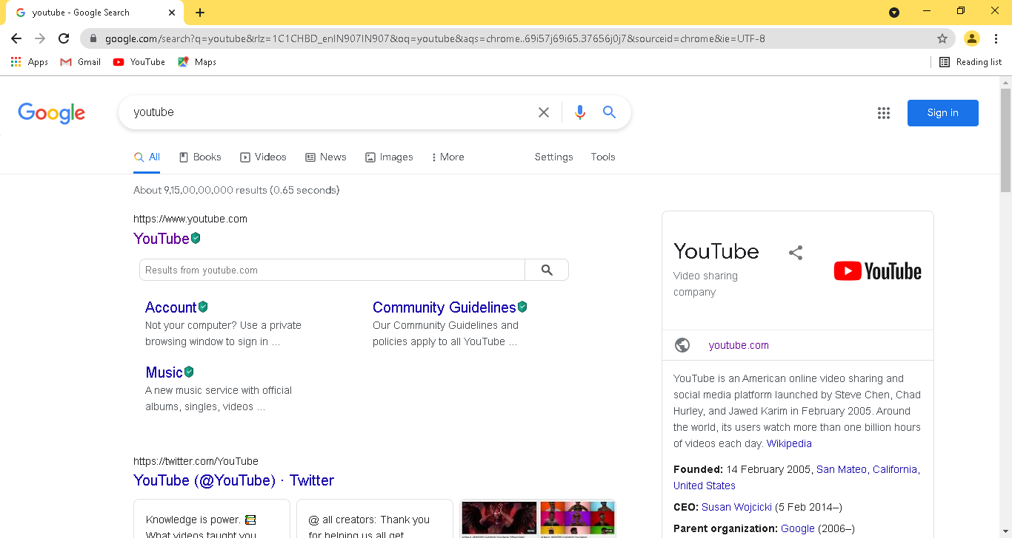
How to watch videos on you-tube?
Open chrome and type youtube in url.
Press enter button.
Click on the first link visible.
And then you search any video by typing name in search box .

Slide 4
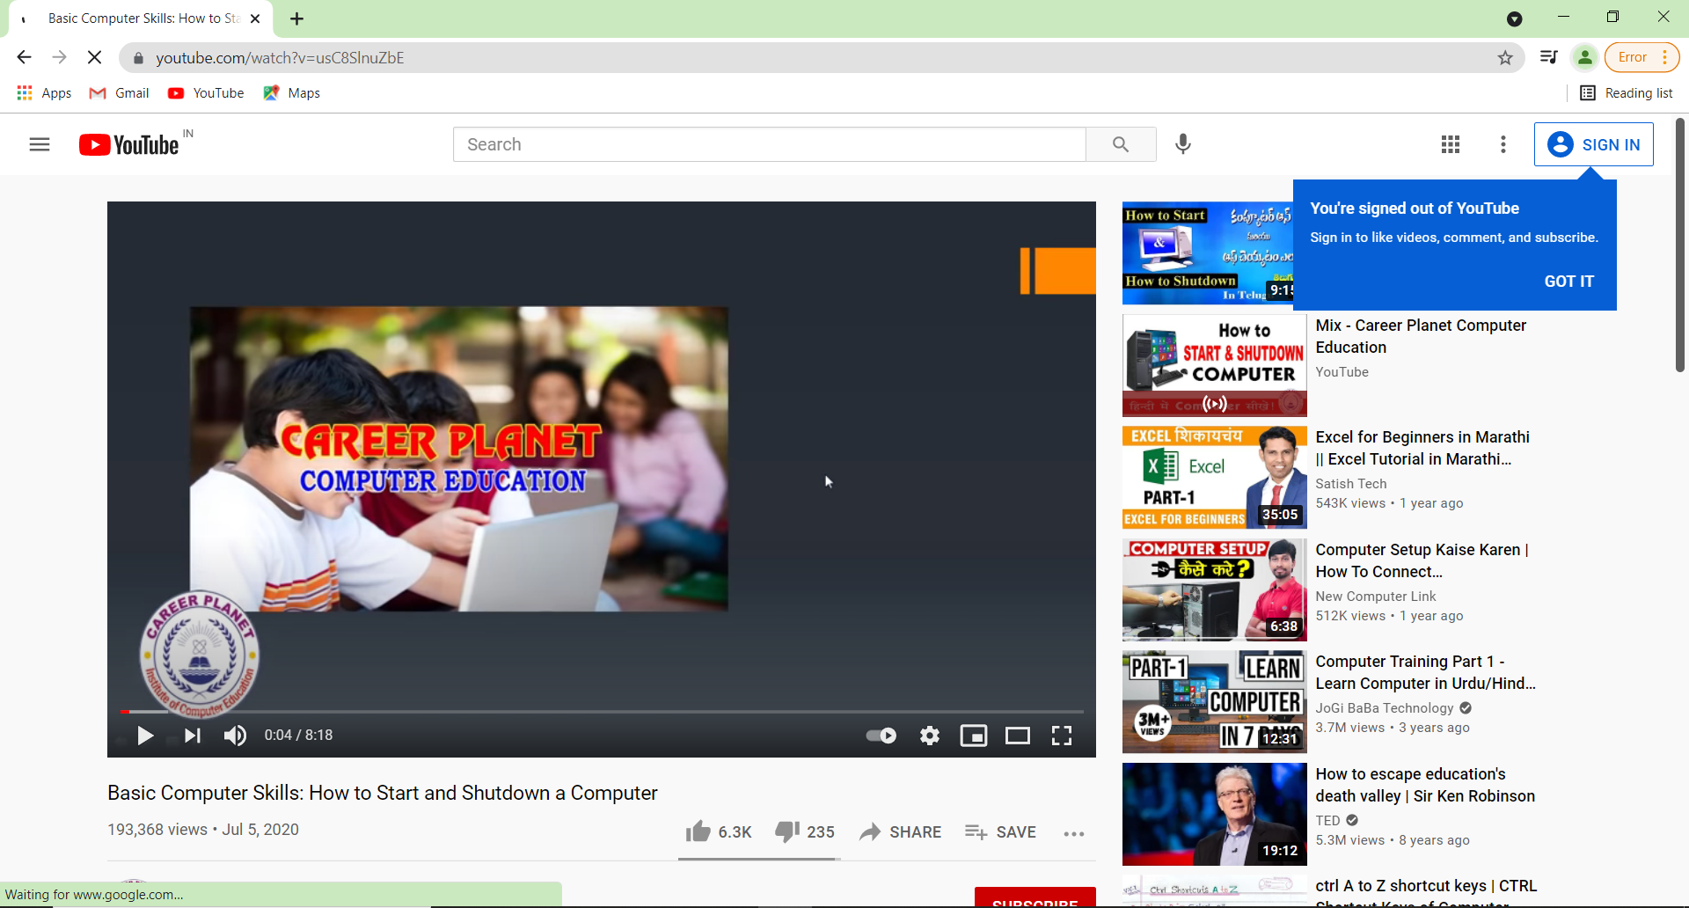
Click on the video which you want to see and the video will play as shown in figure.
Volume
Full-screen
Play & pause

Slide 5

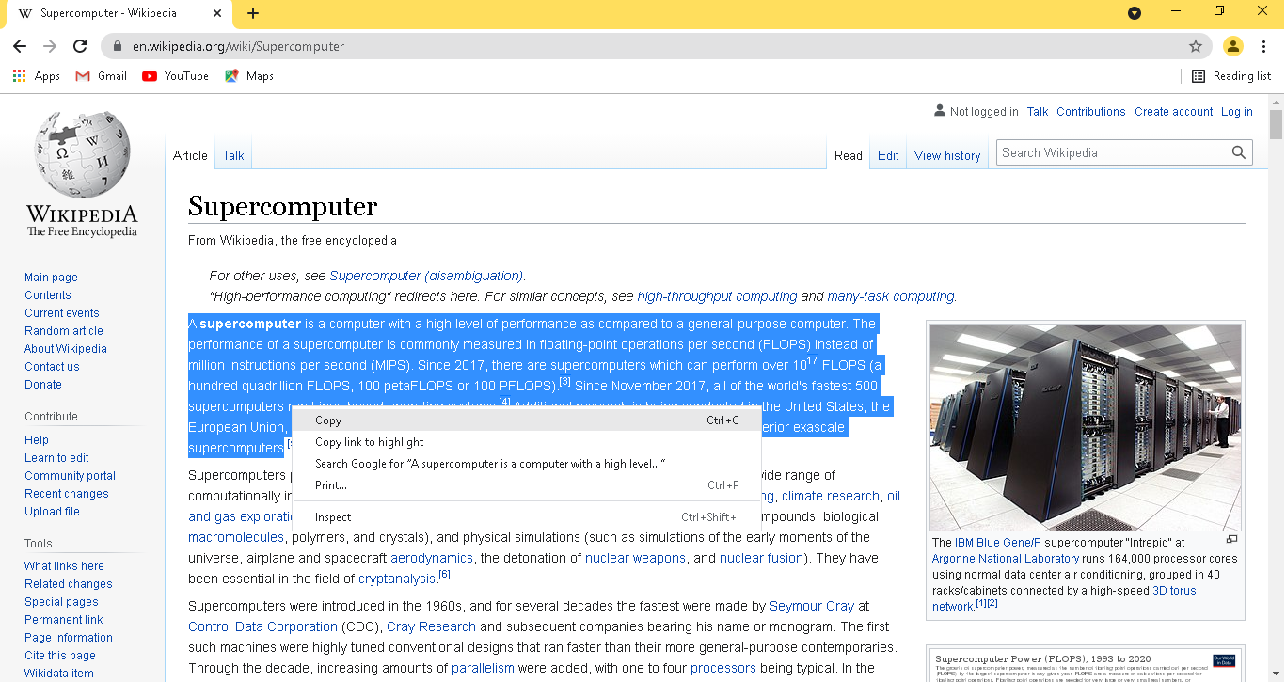
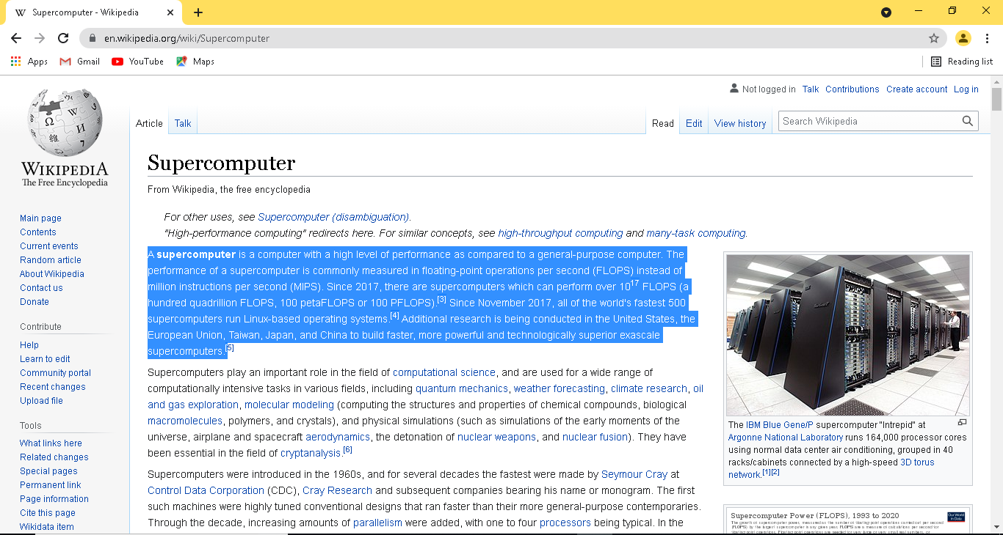
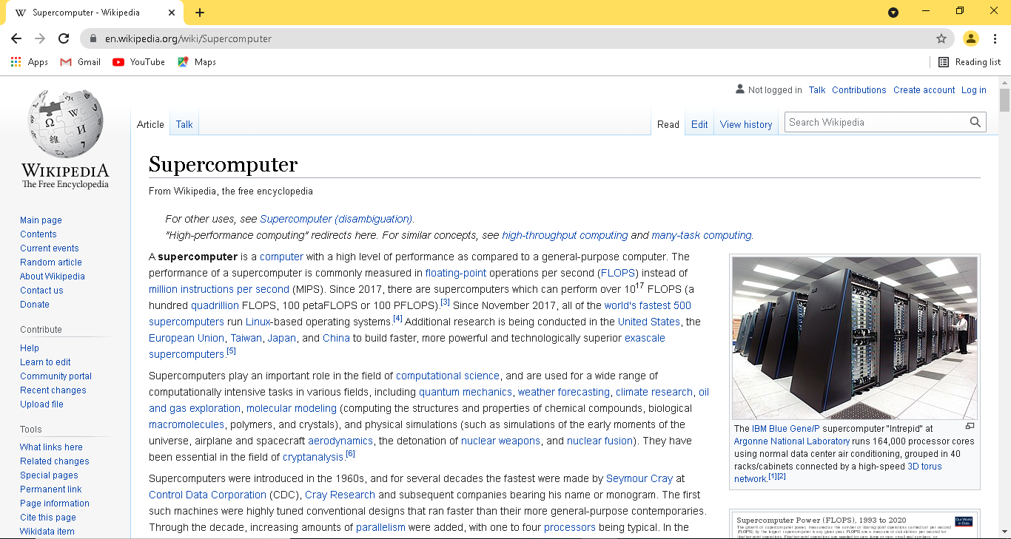
How to copy a text from website?
Open any website you want to copy text from.
Select the text by right clicking and dragging the mouse.
Right click on the text and click copy.
And you can paste it anywhere you want

Slide 6

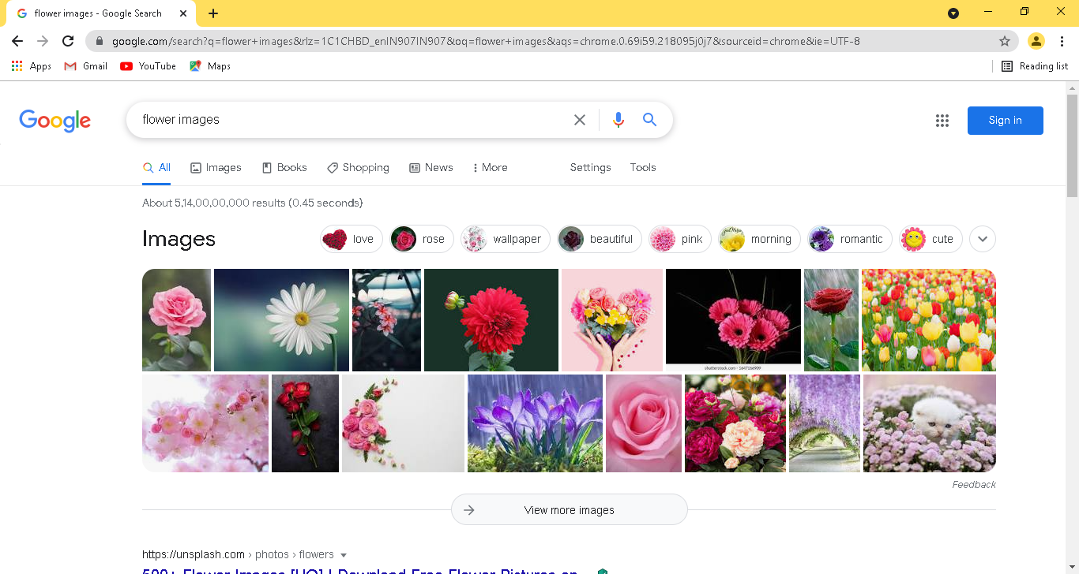
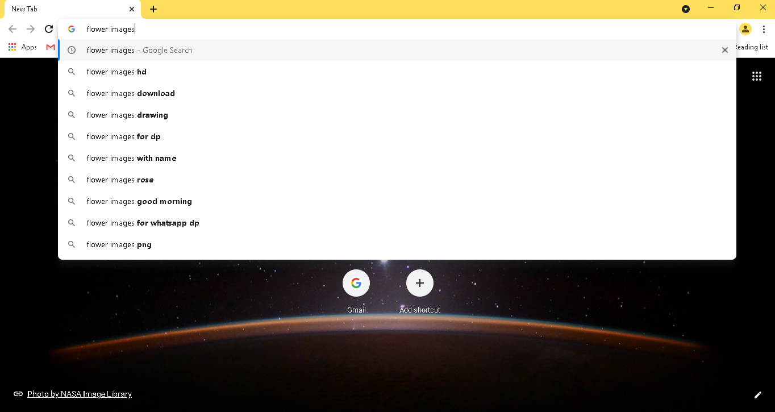
How to download a image from website?
Type name of whatever image you want to download in url. (say here I want a flower)
Click on the images options.

Slide 7
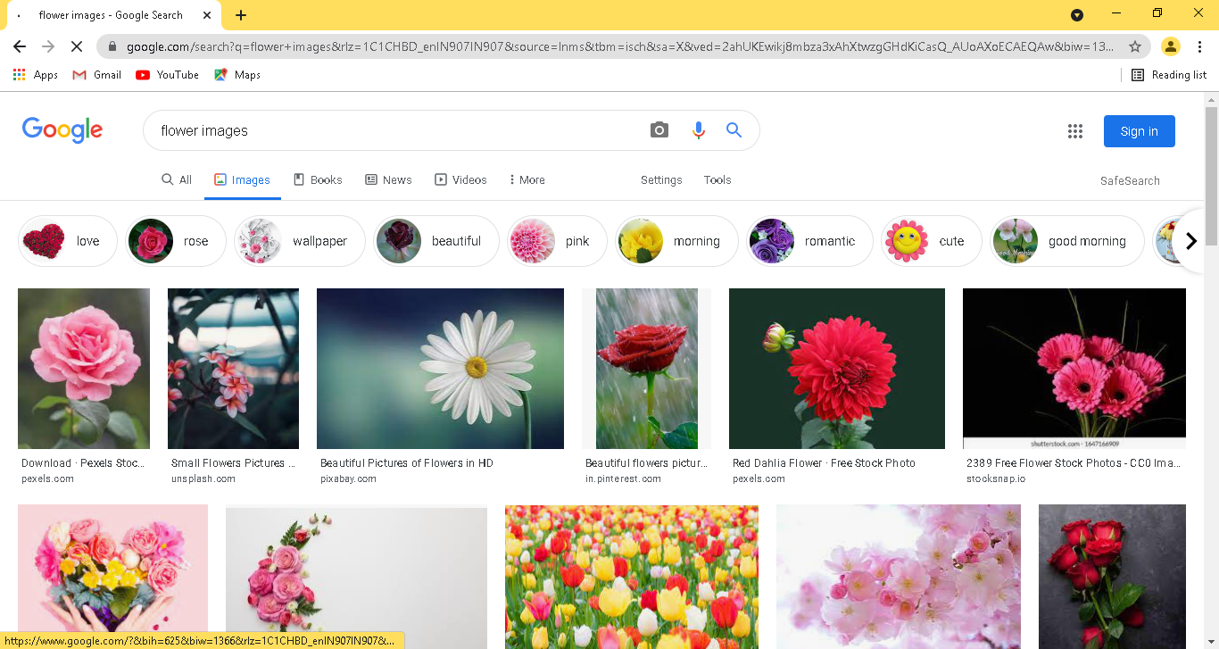
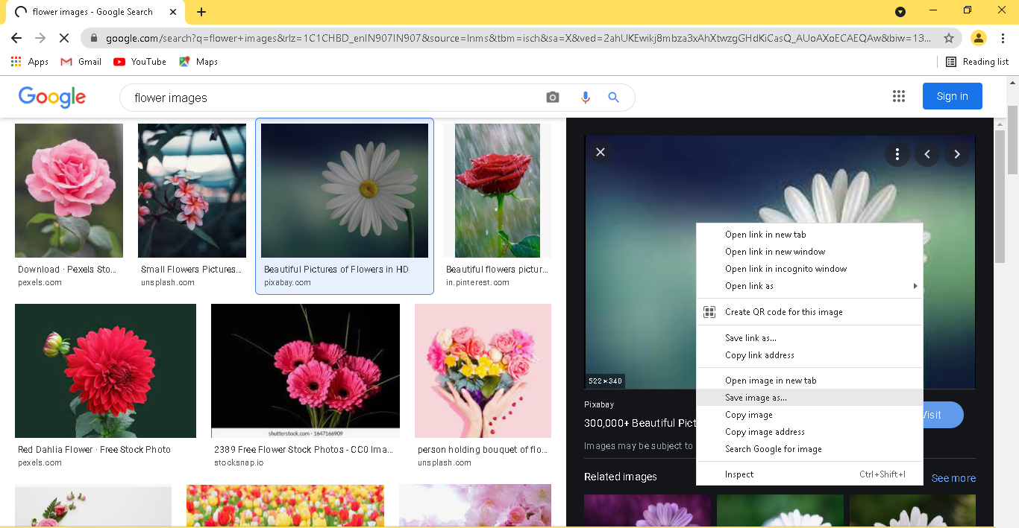
Number of images will appear, click on image which you want.
Now right click on the image which you have opened and click on save image as option.

Slide 8

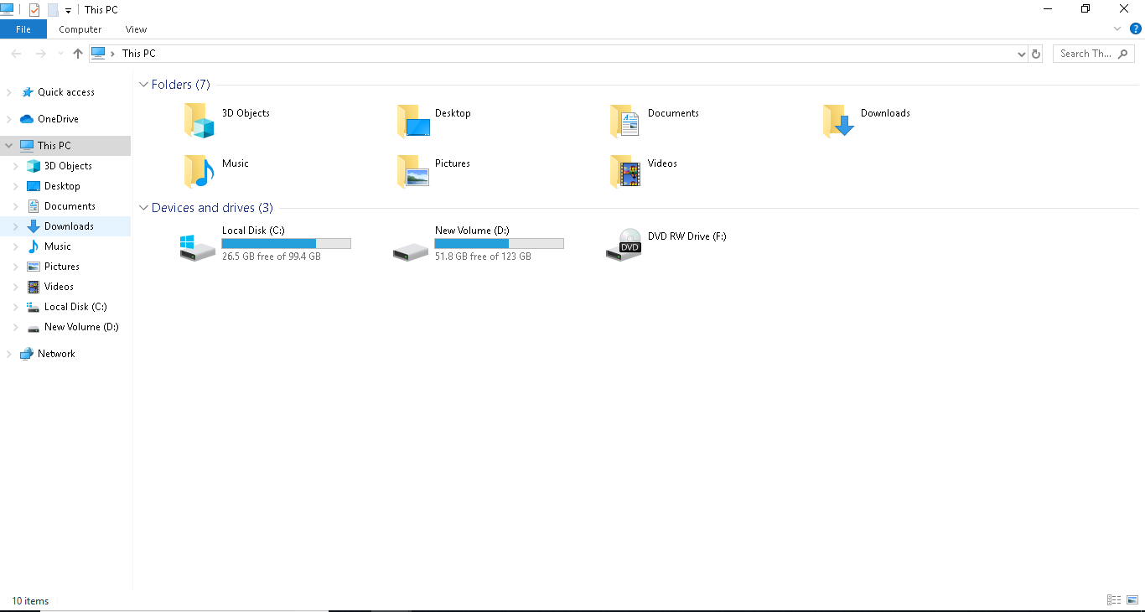
Where will the image be downloded on your computer ?
Any data downloded form website will by deafult get store in the downloads on your computer (if path is not provided).

Slide 9

What is Wikipedia?
Wikipedia is an online free-content encyclopedia project helping to create a world in which everyone can freely share in the sum of all knowledge.
It is supported by the Wikimedia Foundation and based on a model of freely editable content.
Wikipedia was launched on January 15, 2001, by Jimmy Wales and Larry Sanger.

Slide 10
Customization of Chrome

Slide 11

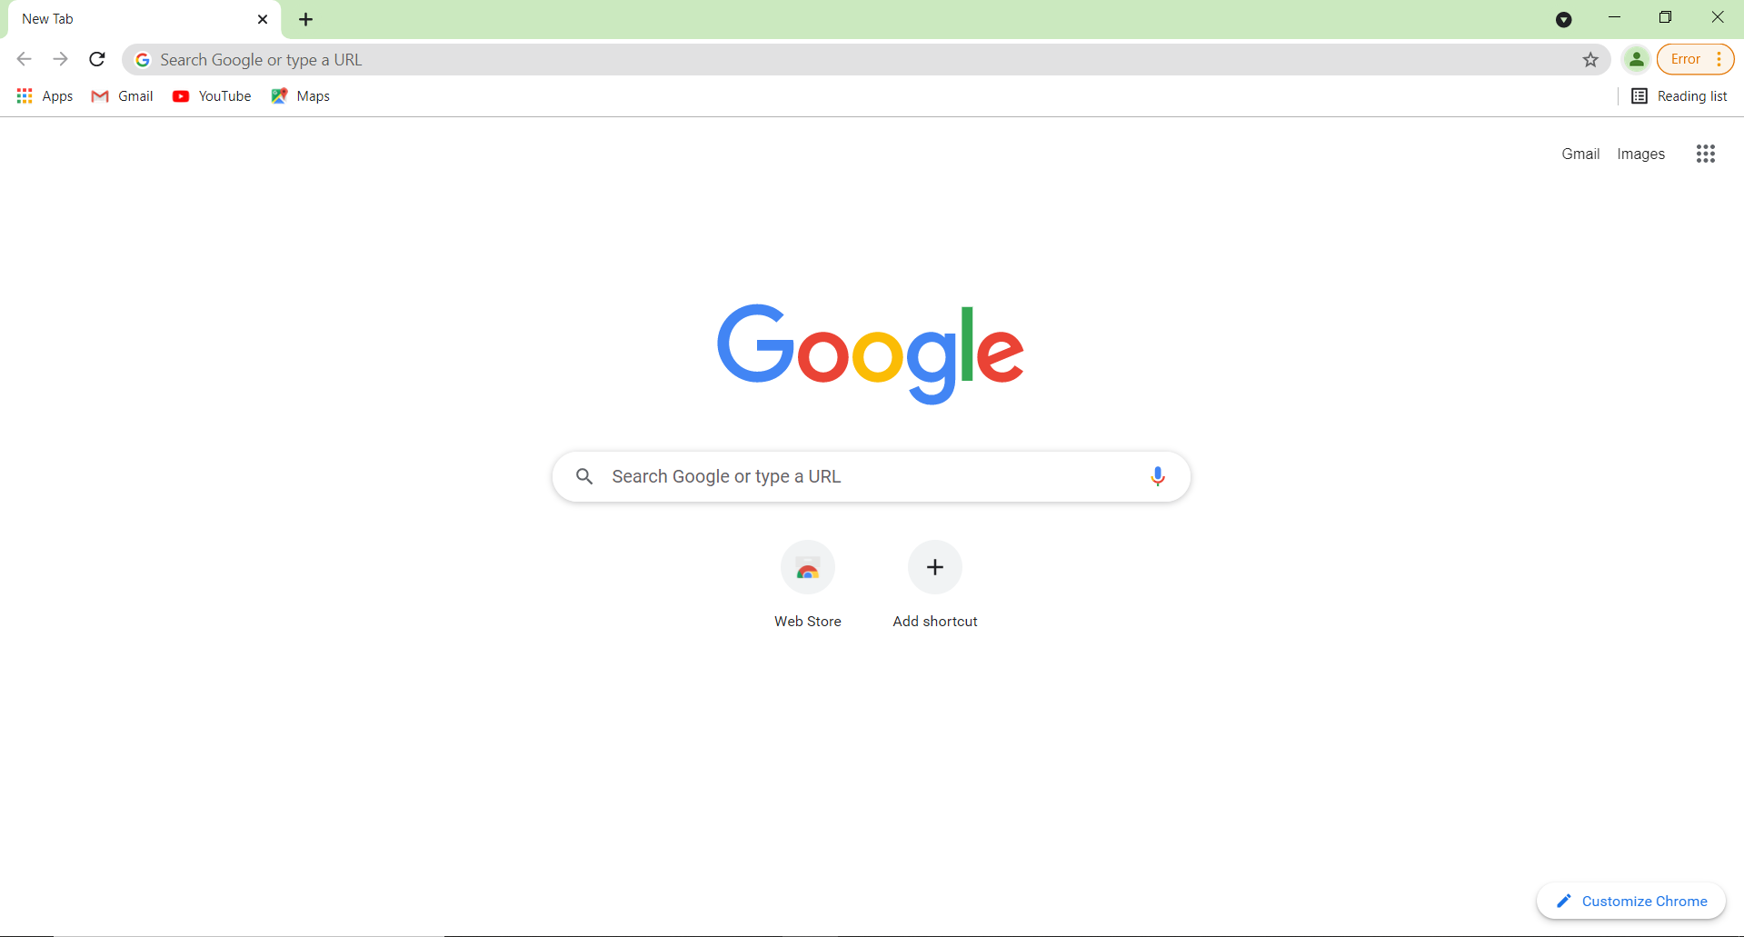
How to add background image to chrome?
Click on customize chrome option

Slide 12
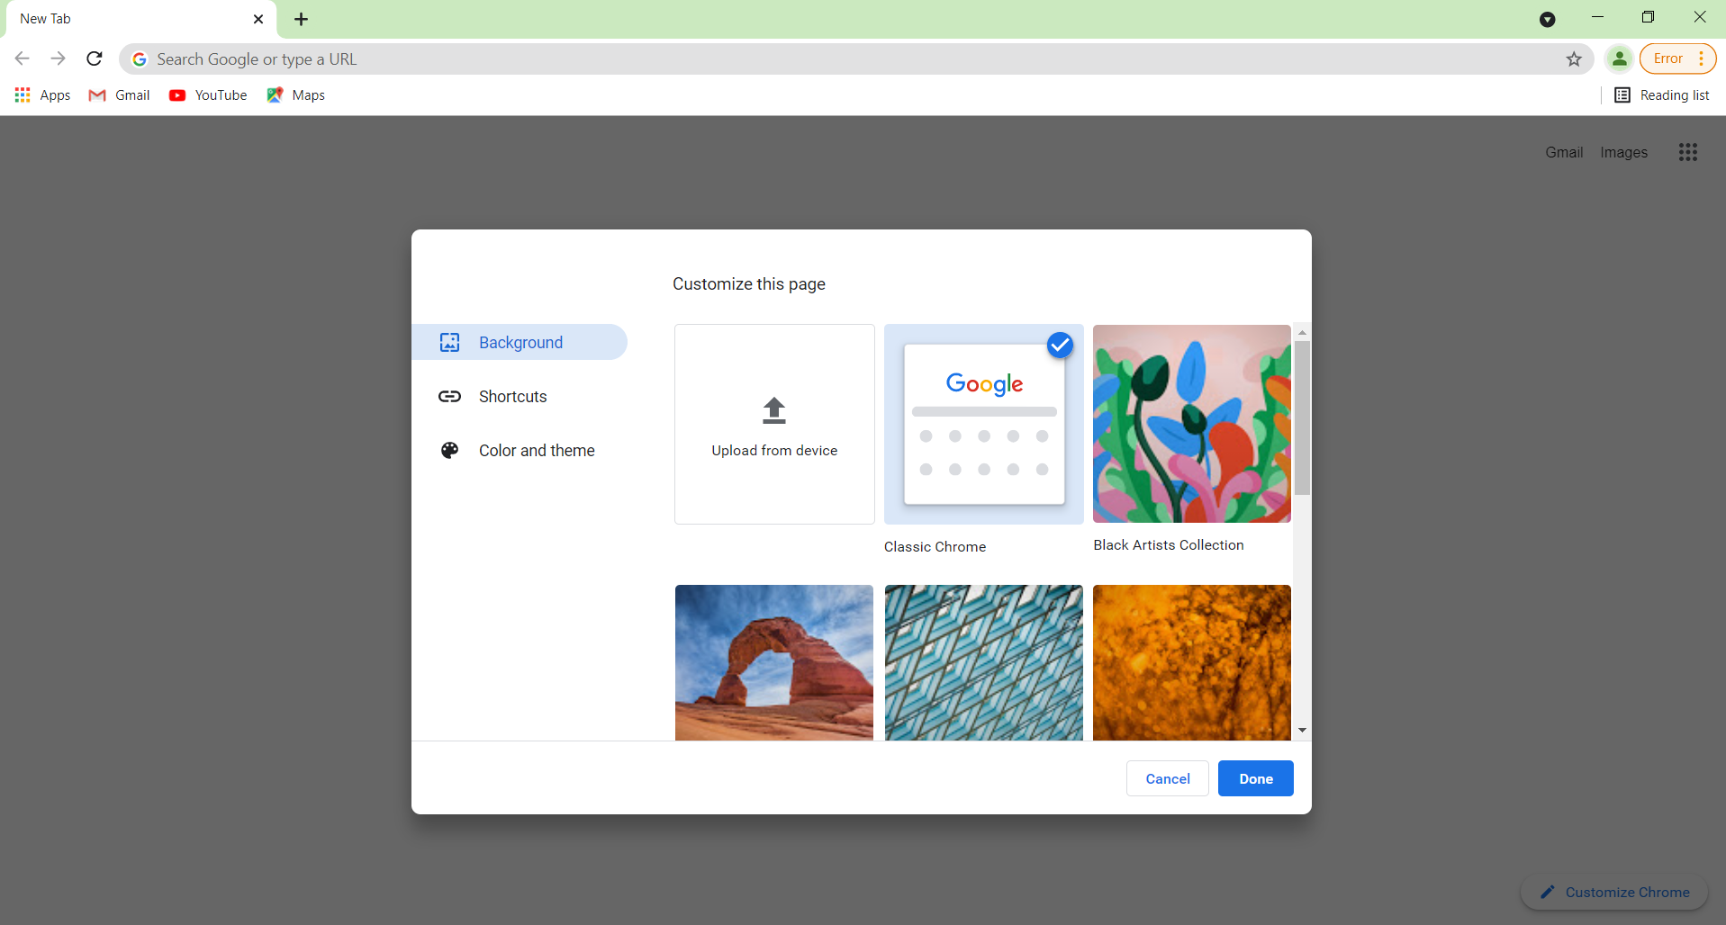
From here you can either add background image that are already present in chrome or you can use upload from device option for image shorted in your computer

Slide 13

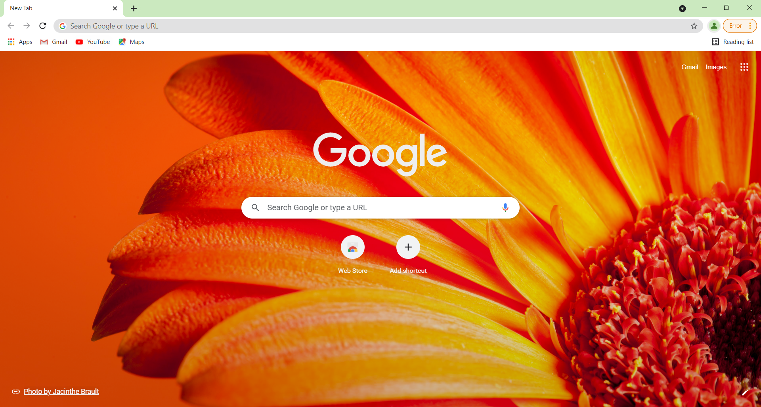
How to add shortcuts?
Click on add shortcut option

Slide 14
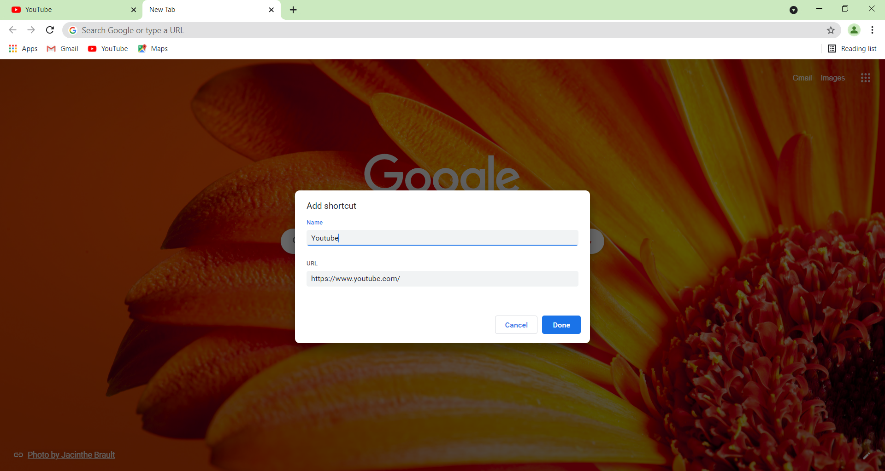
Give name of your choice and copy paste the url of website you want to create shortcut of.

Slide 15

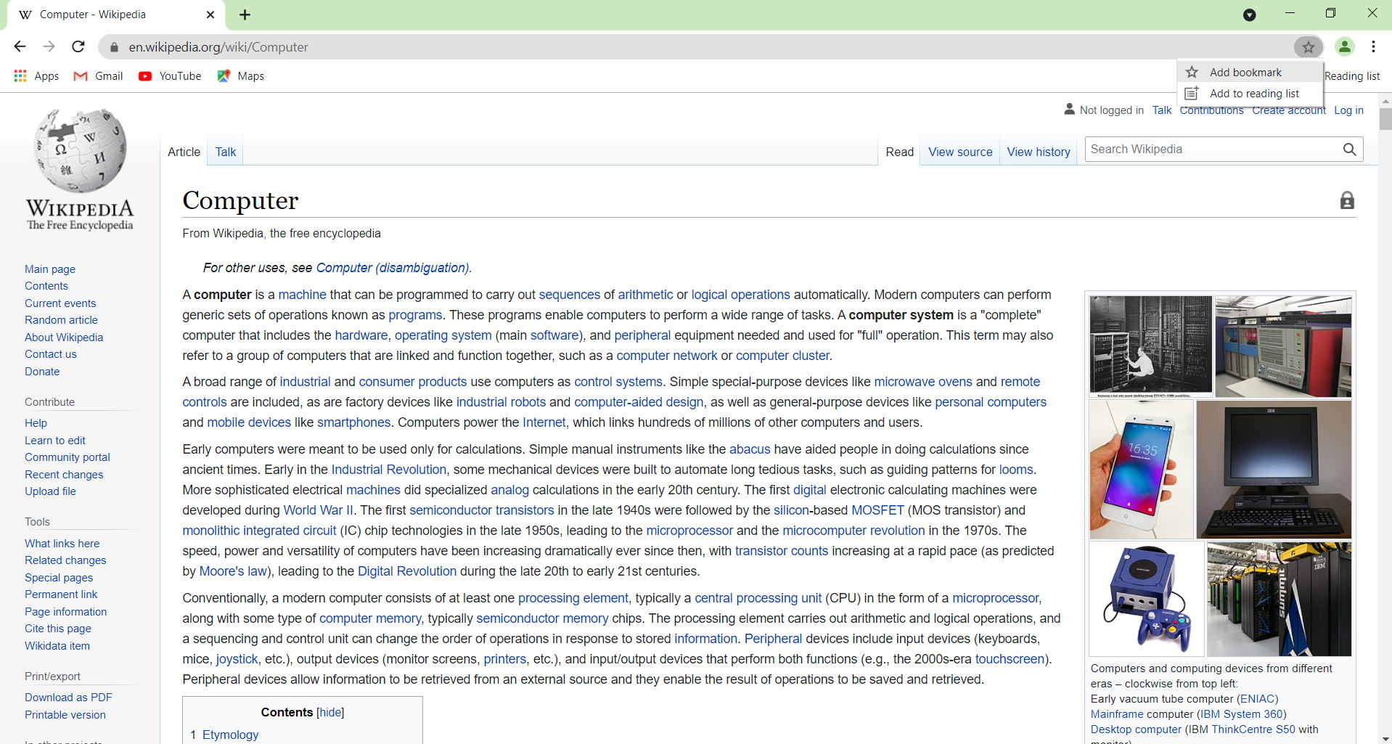
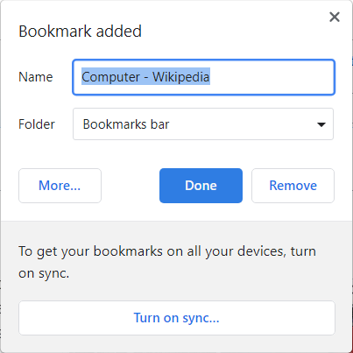
How to add bookmark?
Click on star -> add bookmark in right corner in the url tab.
You can modify the name or keep it as it is and then click Done option.

Slide 16
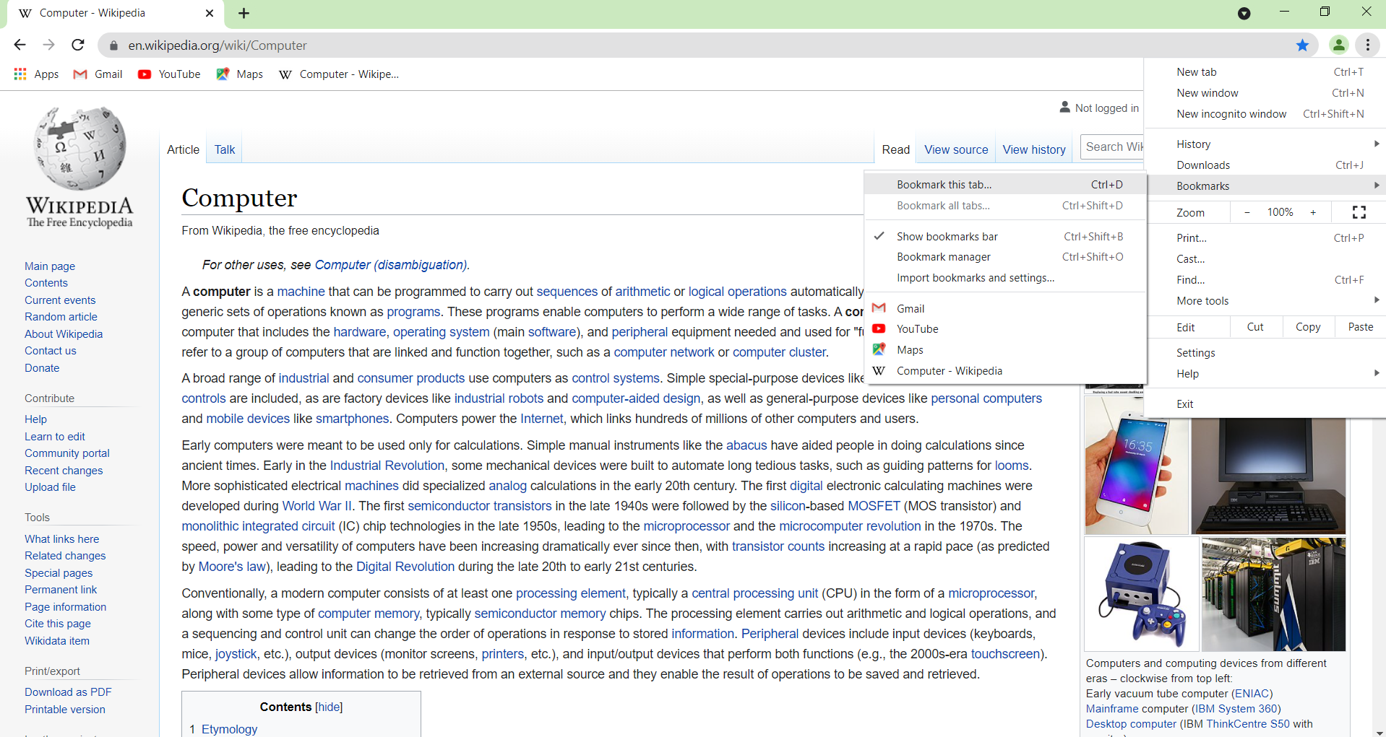
Instead you can Click on the three dot menu in right corner -> Bookmarks -> bookmark this tab (shortcut key – ctrl + D)

Slide 17


